Slide 1
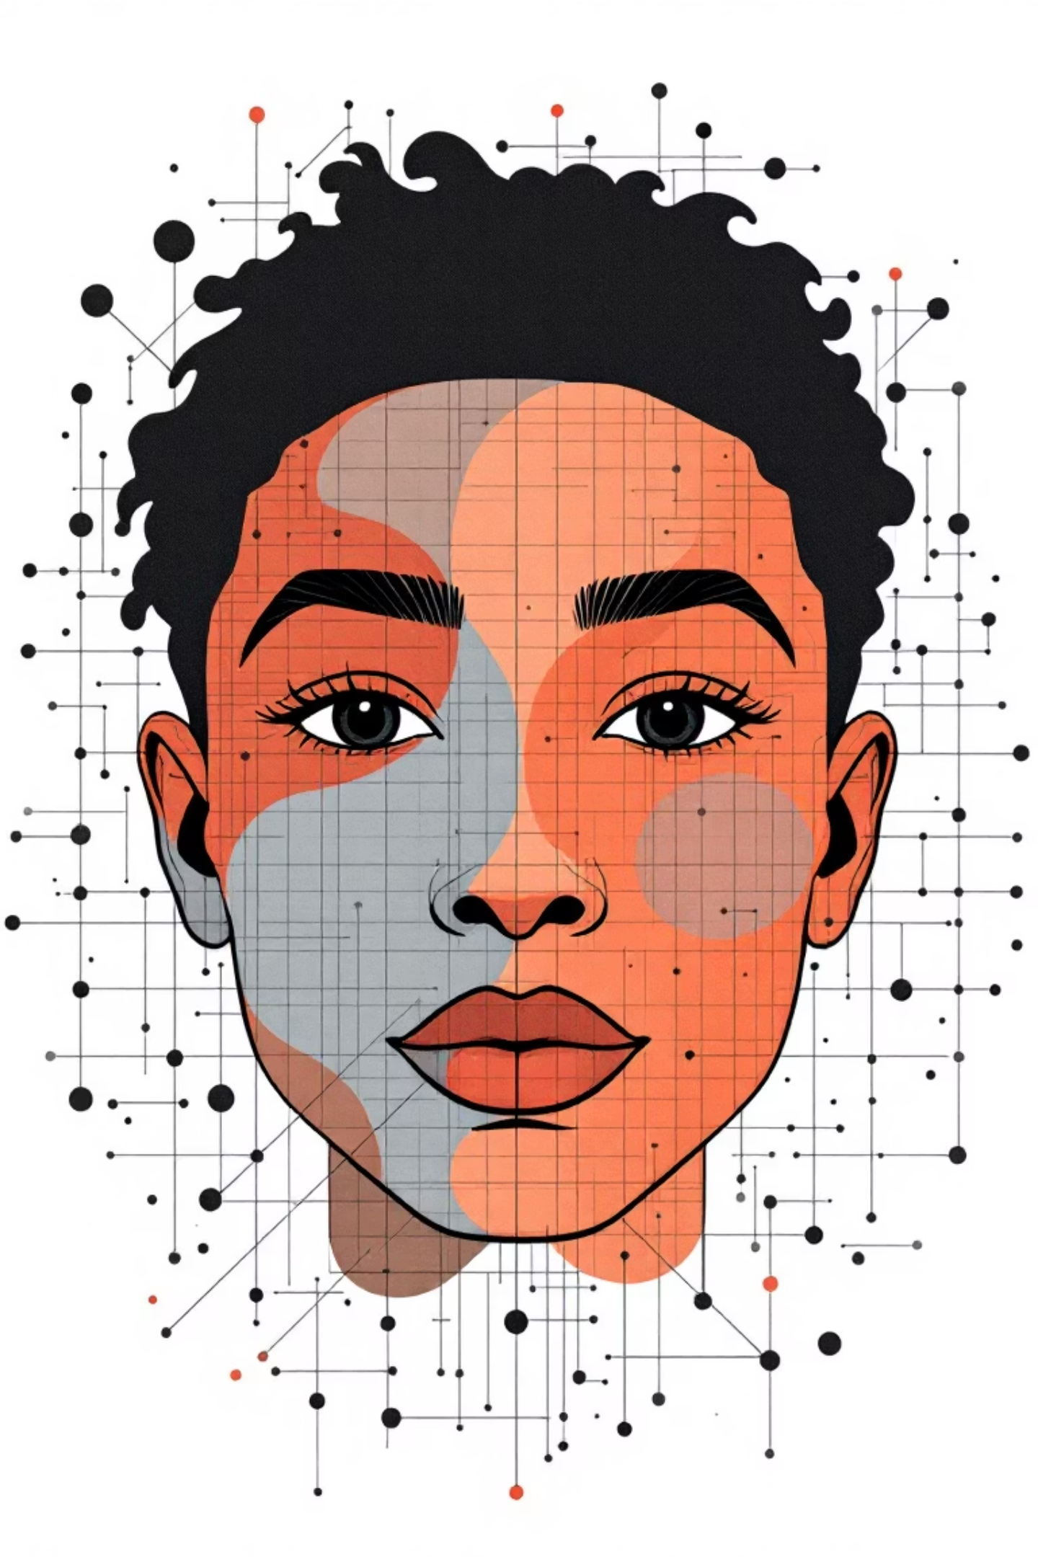
Facial Expression & Emotion Recognition for Social Interaction
Subject – NFT
Group ID – NFT202536
DEEV SHAH – BT23CSE108
VRAJ BORAD – BT23CSE119

Slide 2
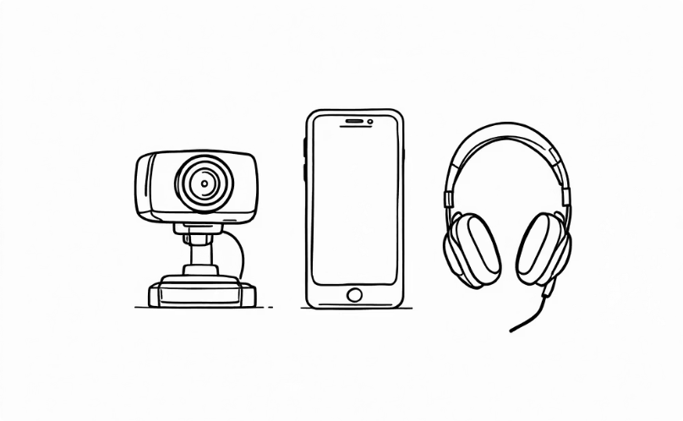

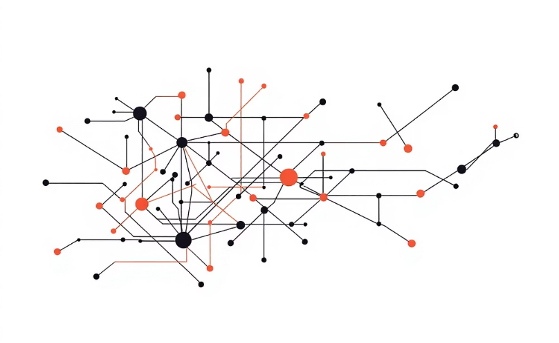
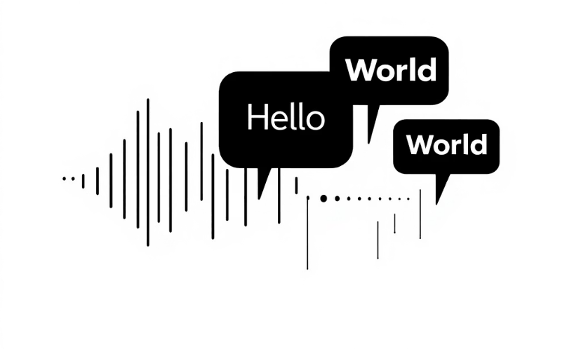
Suggested Tech Stack
Frontend (Input + Output)
Backend (Core Processing)
Neuro-Fuzzy Layer
Audio Feedback
Library: scikit-fuzzy. Purpose: Transforms pre-trained CNN (VGG Face) probabilities into nuanced human-like decisions, detecting subtle emotional blends.
Text-to-Speech (TTS): pyttsx3 (offline).
Example: "The person in front of you looks happy."
Hardware: Laptop webcam or mobile phone camera.
Audio: Headphones or speaker for inclusive feedback.
Language: Python. Frameworks: TensorFlow/Keras or PyTorch with CNN models .
Classification: Categorizes emotions (Happy, Sad, Angry, Neutral, Surprise, Fear, Disgust).

Slide 3
Workflow (Step by Step)
01
02
Step 1: Video Capture
Step 2: Face Detection
03
04
Step 3: Feature Extraction
Step 4: Neuro-Fuzzy Decision
05
06
Step 5: Audio Output
Step 6: Continuous Loop

Slide 4

Step 1 - Video Capture
The first step involves continuously capturing video frames, typically at a rate of around 30 frames per second. These frames are then converted to grayscale and resized. This optimisation significantly reduces the computational load for subsequent processing steps, ensuring faster and more efficient analysis.

Slide 5
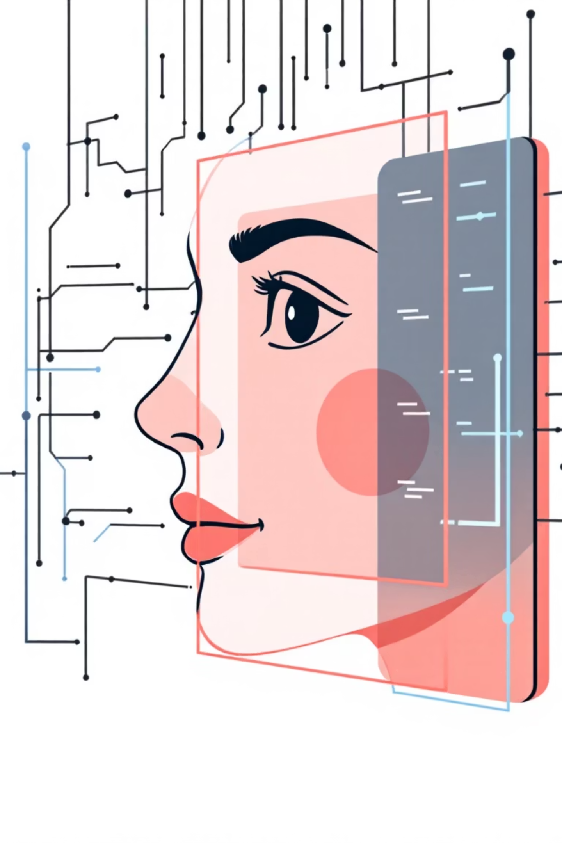
Step 2 - Face Detection
Once video frames are captured, the next crucial step is to employ robust face detection algorithms. Solutions like Haar Cascades (OpenCV) or MTCNN are ideal for this. After a face is successfully detected within the frame, it is accurately cropped to isolate the region of interest. This precise cropping is essential for optimising the subsequent emotion analysis, ensuring that the neural network focuses only on relevant facial features.

Slide 6
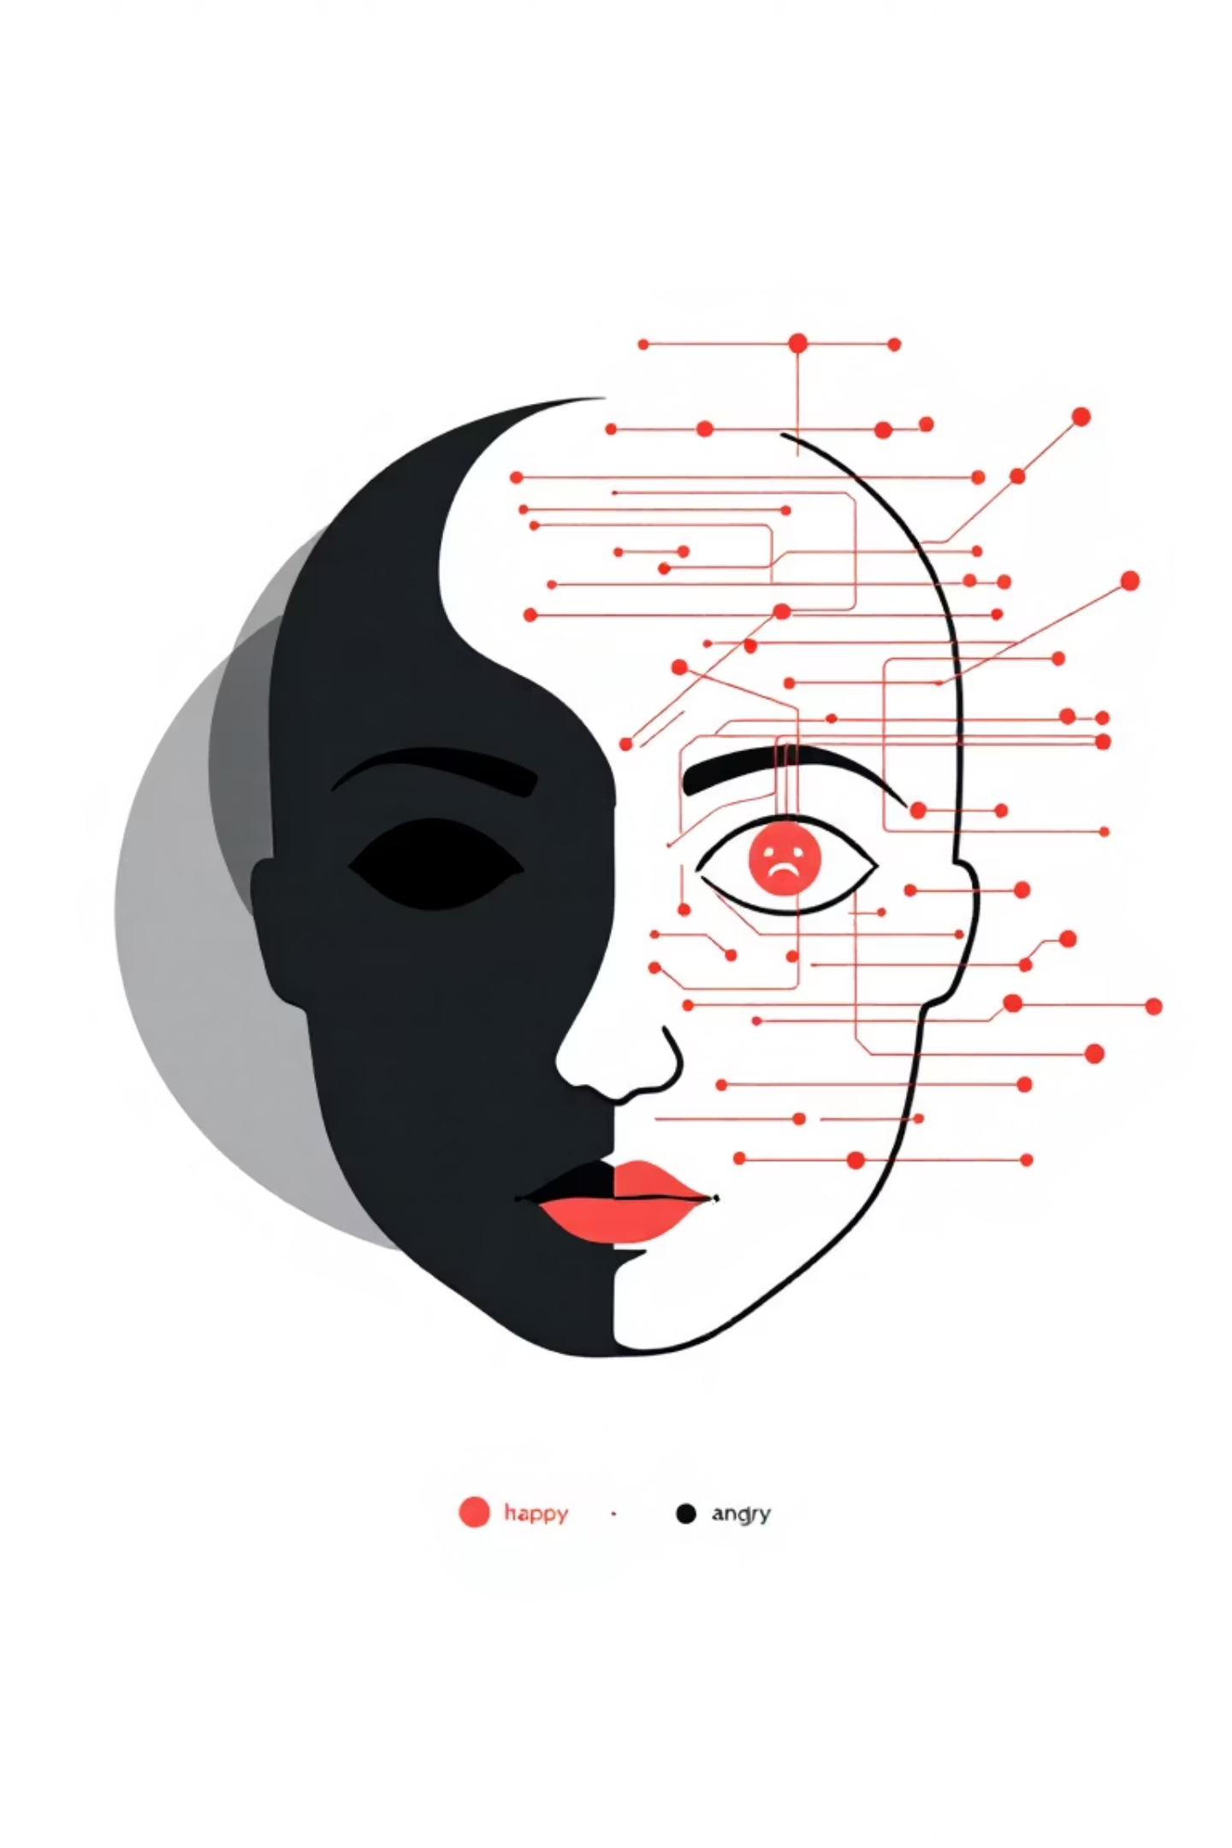
Step 3 - Feature Extraction
The cropped face images are fed into a pre-trained Convolutional Neural Network (CNN) specifically designed for facial expression analysis. This model extracts key features and outputs probabilities for various emotions, for example: Happy (0.65), Sad (0.10), Angry (0.05), Neutral (0.20).

Slide 7
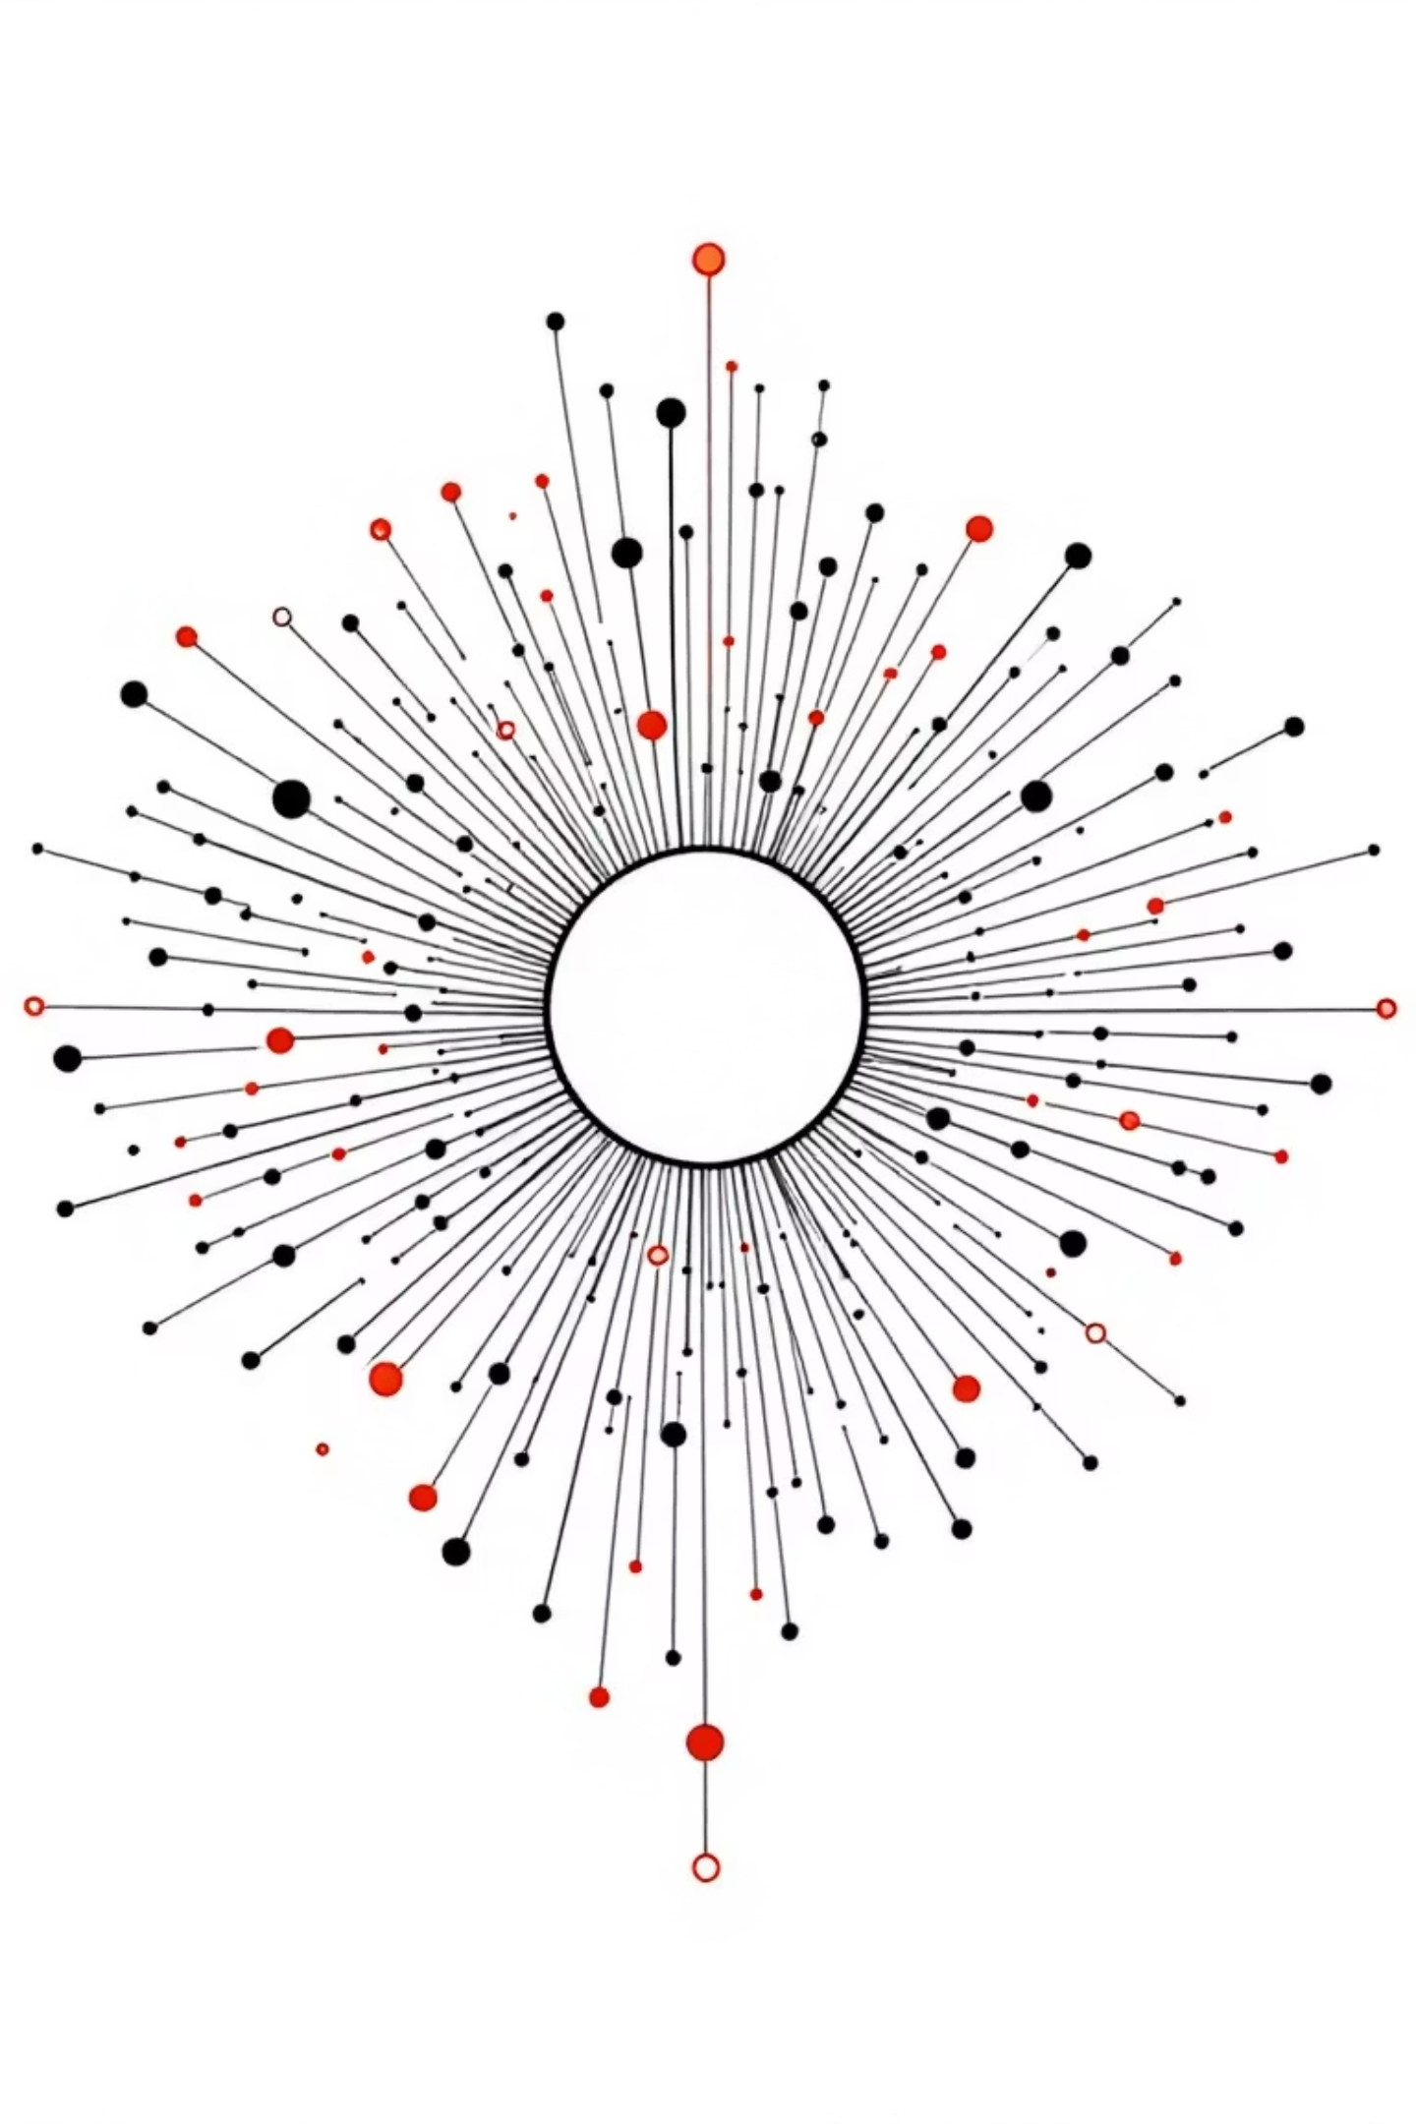
Step 4 - Neuro-Fuzzy Decision
The probabilistic outputs from the Convolutional Neural Network are subsequently processed by a neuro-fuzzy layer. This pivotal step employs predefined fuzzy rules to refine and smooth ambiguous emotional states. By intelligently blending the CNN’s raw probabilities, this layer yields a more robust and confident final emotion label, ensuring nuanced and accurate interpretation of facial expressions.

Slide 8
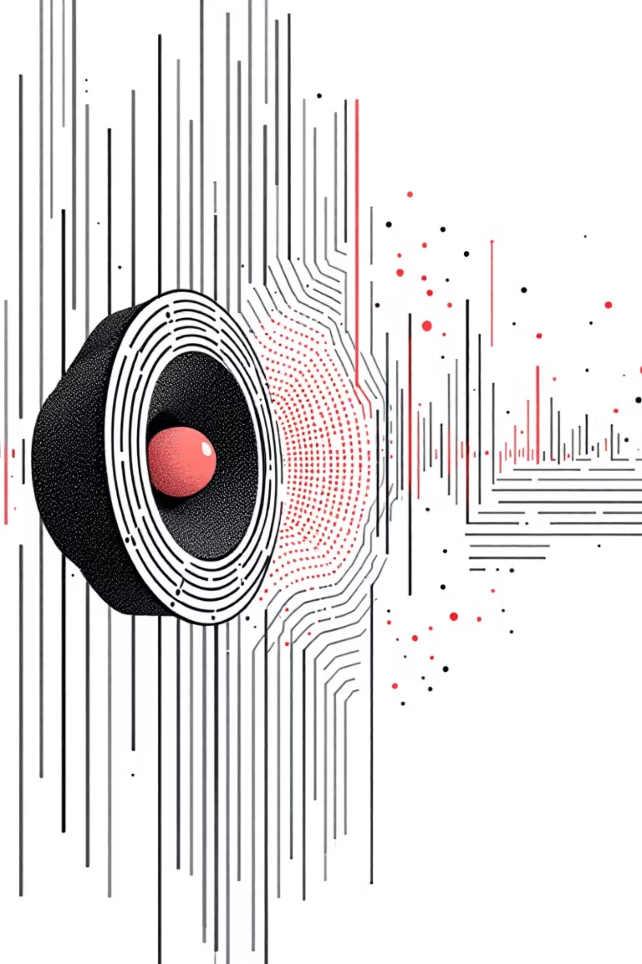
Step 5 - Audio Output
The refined emotion label from the neuro-fuzzy layer is then translated into audible feedback. This is achieved using a Text-to-Speech (TTS) engine, which converts the text label into spoken words. For instance, if the detected emotion is "Happy", the system would vocalise, "The person looks happy." This real-time audio cue is crucial for providing immediate, accessible information to blind users, facilitating dynamic social interactions.

Slide 9
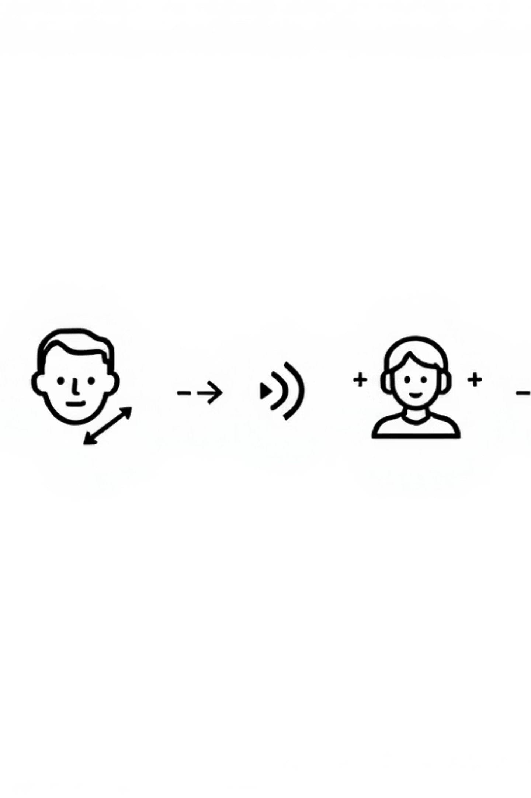
Step 6 - Continuous Loop
The system operates in a continuous, real-time loop, capturing frames, detecting emotions, and providing instant audio feedback. To prevent 'audio fatigue,' a 2-3 second interval is implemented before repeating the same emotion, ensuring clarity without excessive repetition and maintaining a smooth user experience.

Slide 10
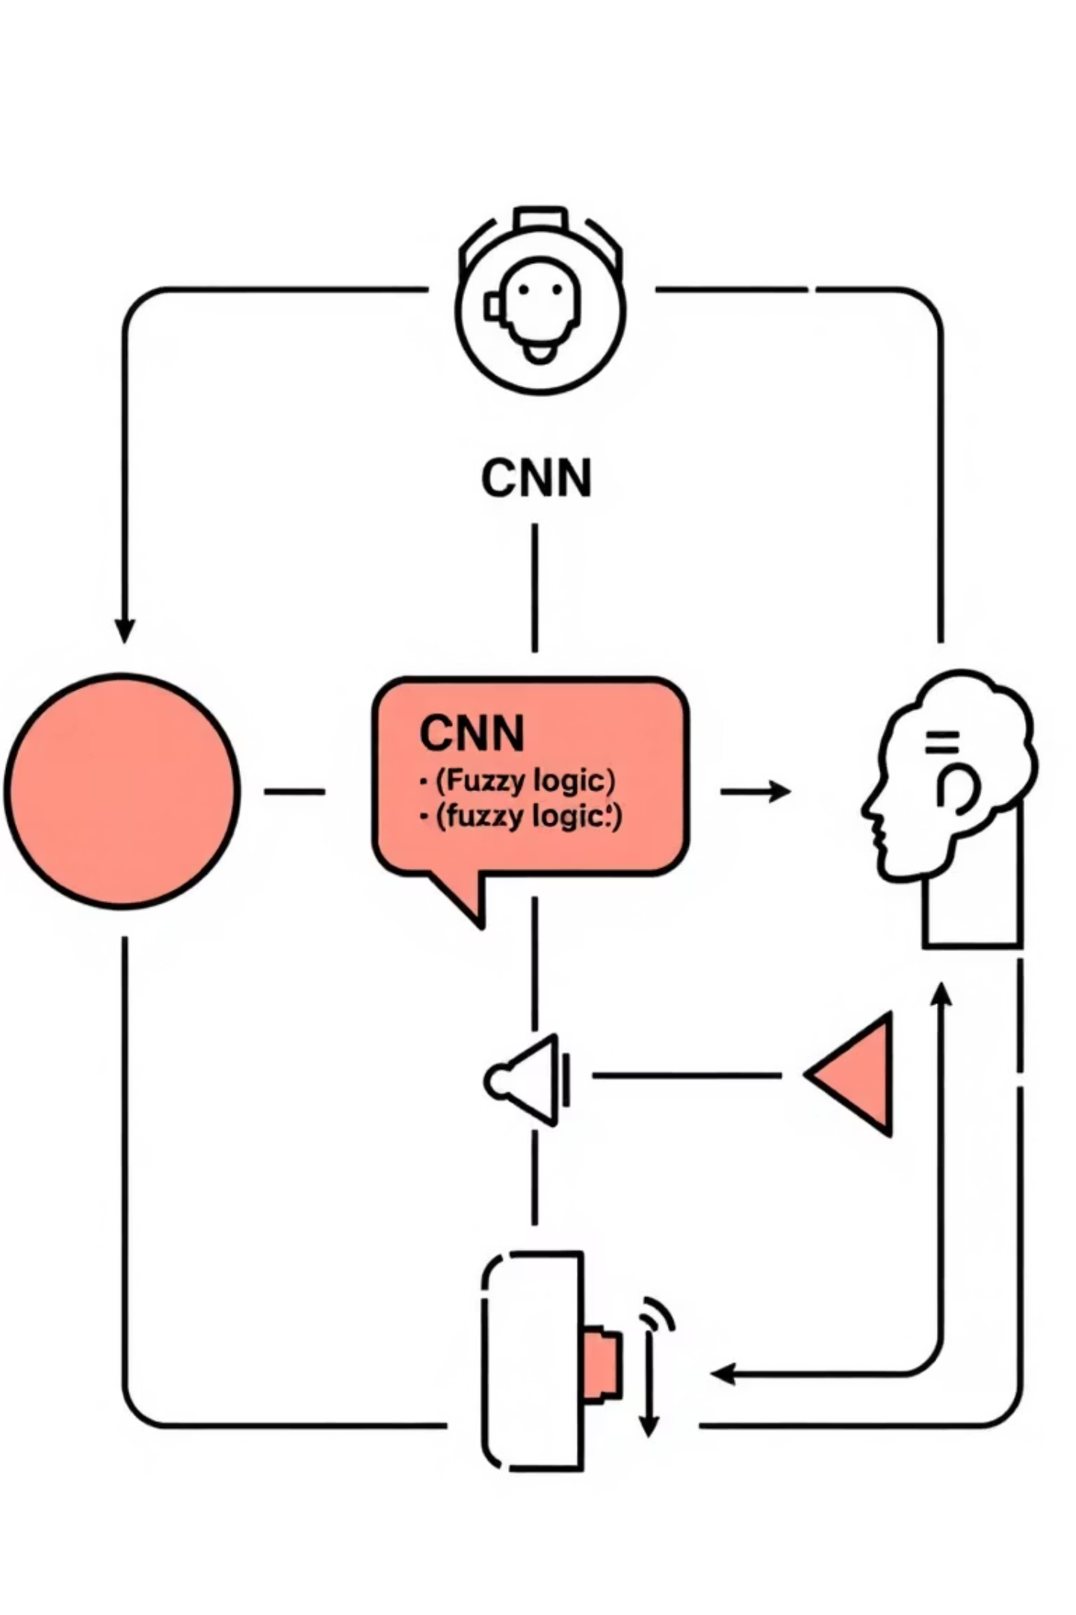




Example Flow in Simple Terms
Camera Sees
The camera captures an image and detects a face within the frame.
CNN Guesses
The Convolutional Neural Network processes the face and predicts: "probably happy (65%)."
Fuzzy Logic Checks
The fuzzy logic system evaluates: "Is Happy > medium AND Neutral < low?" If true, it confirms "Happy."
System Speaks
The Text-to-Speech component vocalises: "The person in front of you is happy."

Slide 11
Why This Stack?
This chosen technology stack offers a pragmatic balance of accessibility, performance, and cost-effectiveness for your emotion recognition prototype. It leverages industry-standard tools while integrating innovative components to deliver a robust and user-friendly solution.
Python + Keras/PyTorch: Provides a simple, yet powerful, and widely adopted environment for machine learning development.
scikit-fuzzy: Seamlessly integrates fuzzy logic to refine emotion classification, leading to more nuanced and accurate interpretations.
OpenCV: Offers straightforward and efficient solutions for real-time face detection and image processing.
pyttsx3: Enables offline text-to-speech functionality, ensuring consistent feedback regardless of internet connectivity.

